Slide 1

Advanced Mechanics
(Lecture 5)
ANNOUNCE / BUSINESS
HW 2 (due H, 1/23)
HW 3 (due W, 1/29)*
Exam 1: H, 1/30
NEW STUFF
Questions?
Material properties
Elasticity

Slide 2
Engineering Materials
In any solid mechanics problem, we generally have 15 parameters to define
3 displacements, 6 strains, 6 stresses
What equations can we use to define these?
Equations of equilibrium: 3 equations
Kinematic (i.e., strain-displacement) relations: 6 equations
We need 6 more equations …
Material-dependent stress-strain relations (6 eqn’s)
$$σ=σ(ε)$$
(“material model” or “constitutive function”)

Slide 3
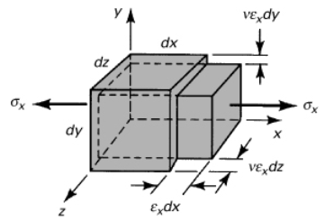


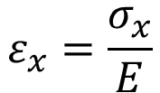
Hooke’s Law
Linear, elastic material in elastic regime
Example: Find strain of block in uniaxial tension, assuming isotropy
$$ε_{x}=\frac{σ_{x}}{E}$$
Be super careful when using this “apparent” definition: It only works for uniaxial tension loading without any addition boundary conditions!
(note non-zero strain in transverse directions even though there is no stress in those directions!)
Notes:
e - dilatation

Slide 4
Hooke’s Law
Let’s change this up a little to introduce multiple axes of loading. For example, what if our block of material is embedded in a rigid container and is loaded in compression?
Can we determine the 3-D strains?
Let’s get back to this.

Slide 5
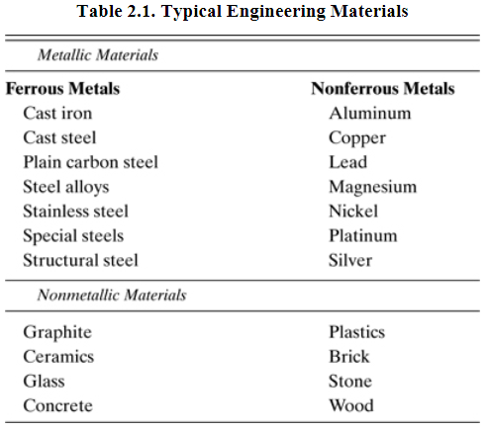
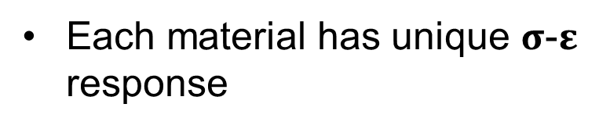
Engineering Materials
Each material has unique $σ$-$ε$ response

Slide 6
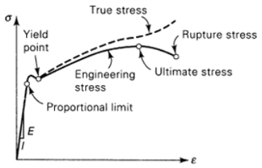
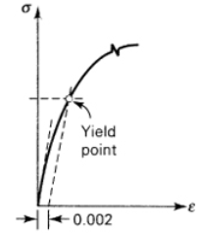
Mechanical Behavior – Terminology
Linear v. nonlinear (shape of curve … usually limited to elastic region)
Elastic v. inelastic (recovery of original configuration)
Yield point (or proportional limit; 0.2% offset)
Ultimate stress / strength; rupture stress / strength
Ductile v. brittle
Isotropic v. anisotropic (material symmetry)

Slide 7
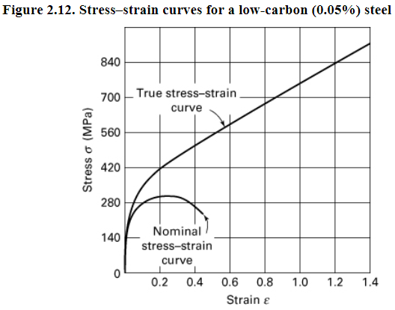


Engineering (Nominal) v. True Stress/Strain
Measures are essentially the same prior to yield
True and engineering strain
true strain:
eng strain
True and engineering stress
material assumed incompressible (constant volume) in plastic regime
true stress:

Slide 8
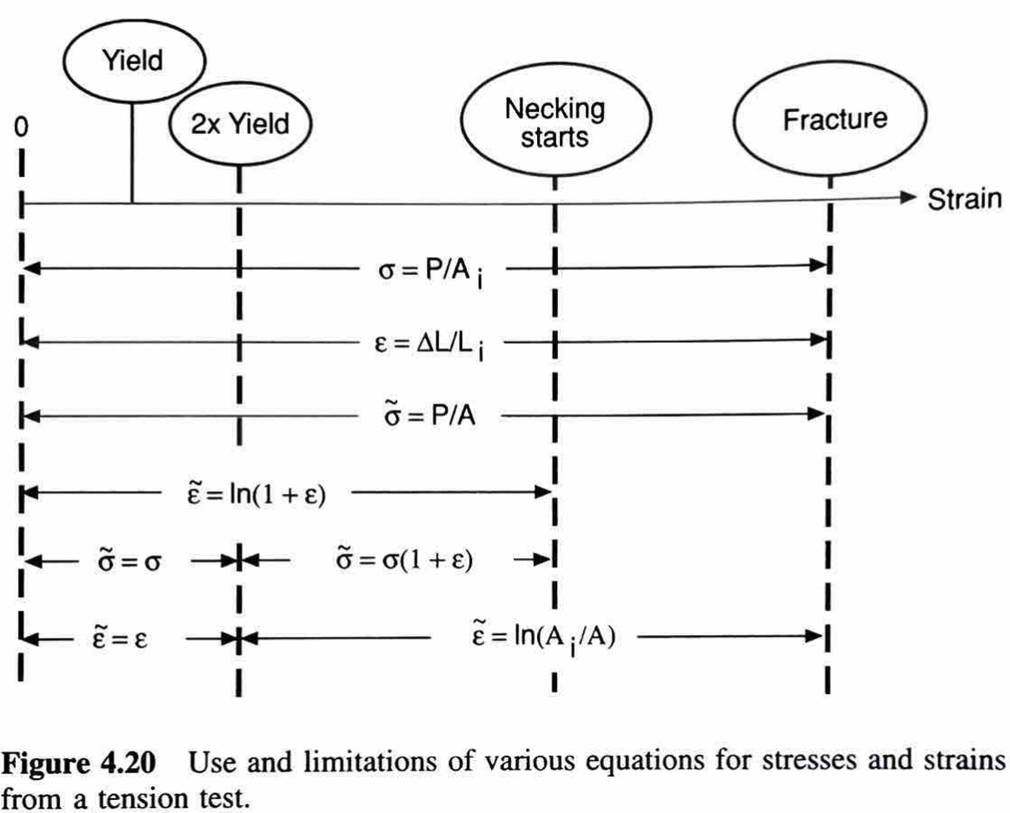
Engineering (Nominal) v. True Stress/Strain
Dowling

Slide 9
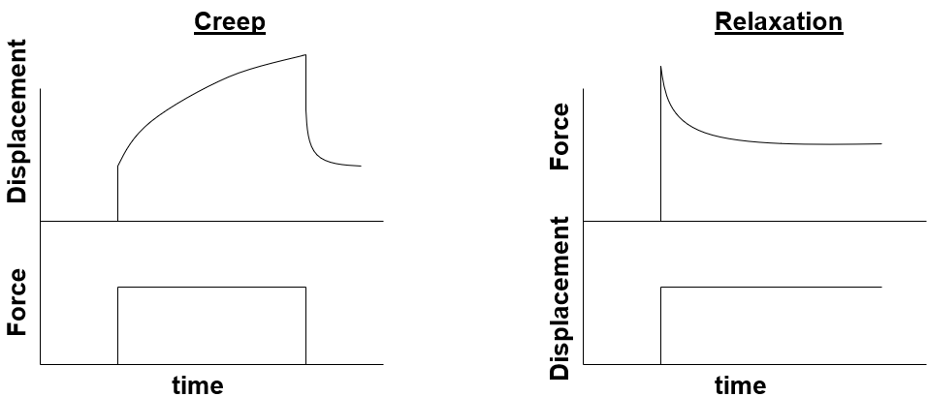


Viscoelasticity
Dependent on both strain and strain rate
Elastic since returns to unloaded configuration
Modeled as combination of springs and dashpots, e.g.,
F
$$F=μx$$
$$F=η\dot{x}$$
F
Notes:
Silly putty demo

Slide 10
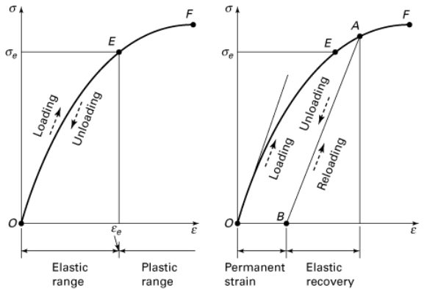
Elastic v. Plastic
fracture
elastic
limit
Notes:
E: elastic limit; F: fracture
Unloading / reloading occur at original slope
New elastic limit, with material becoming brittle; cold-working

Slide 11
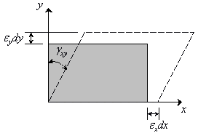

Hooke’s Law
If shear,

Slide 12
Hooke’s Law
Back to our confined compression problem … how can we account for multiaxial stresses?

Slide 13
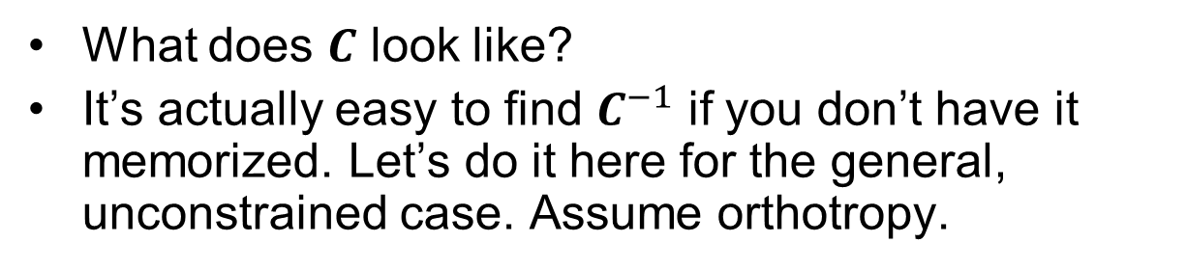
Generalized Hooke’s Law
What does $C$ look like?
It’s actually easy to find $C^{−1}$ if you don’t have it memorized. Let’s do it here for the general, unconstrained case. Assume orthotropy.
Notes:
Find C for orthotropic material … consider three cases: uniaxial loading in each of the directions.

Slide 14
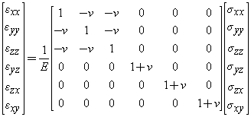
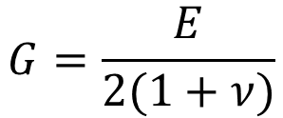
Generalized Hooke’s Law – Isotropic Material
Note that an isotropic material is fully defined by just 2 material parameters since it can be shown that
$$G=\frac{E}{2(1+ν)}$$

Slide 15
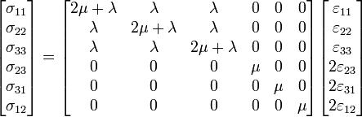
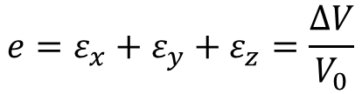
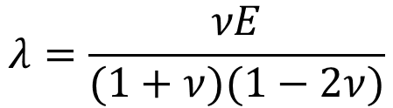

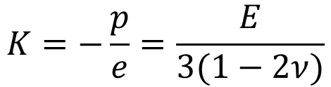

Generalized Hooke’s Law – Isotropic Material
Alternatively …
where λ and μ are the Lamé constants:
$$λ=\frac{νE}{(1+ν)(1−2ν)}$$
and
$$μ=G$$
We also introduce the bulk modulus of elasticity $K$, which defines volume change under hydrostatic pressure:
$$K=−\frac{p}{e}=\frac{E}{3(1−2ν)}$$
$$−p=σ_{x}=σ_{y}=σ_{z}$$
where
$$e=ε_{x}+ε_{y}+ε_{z}=\frac{∆V}{V_{0}}$$
(“dilatation”)

Slide 16
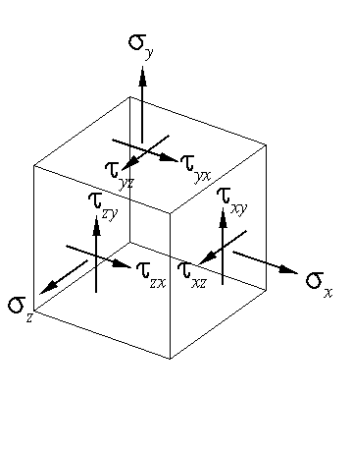
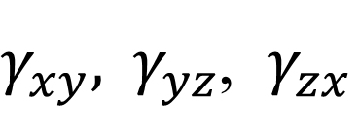
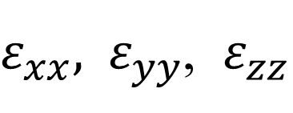
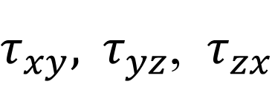
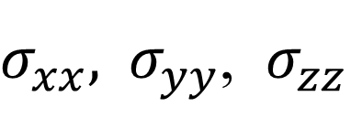
Three-Dimensional Stress-Strain
unique stress values
$σ_{xx},{ σ}_{yy}$, $σ_{zz}$
$τ_{xy},{ τ}_{yz}$, $τ_{zx}$
unique strain values
$ε_{xx},{ ε}_{yy}$, $ε_{zz}$
$γ_{xy},{ γ}_{yz}$, $γ_{zx}$

Slide 17

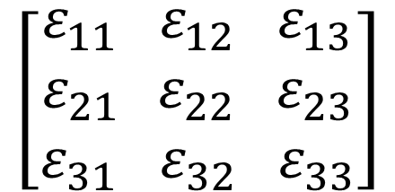
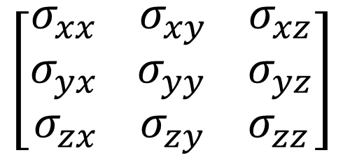
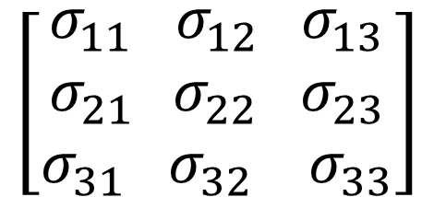
Stress and Strain Tensors
σ
symmetric
ij = ji
ε
$$\left[\begin{aligned}σ_{xx}{ σ}_{xy}{ σ}_{xz} \\ σ_{yx }{ σ}_{yy}{ σ}_{yz} \\ σ_{zx}{ σ}_{zy}{ σ}_{zz}\end{aligned}\right]$$
$$\left[\begin{aligned}ε_{xx}{ ε}_{xy}{ ε}_{xz} \\ ε_{yx }{ ε}_{yy}{ ε}_{yz} \\ ε_{zx}{ ε}_{zy}{ ε}_{zz}\end{aligned}\right]$$
If x = 1, y = 2, z = 3
$$\left[\begin{aligned}σ_{11}{ σ}_{12}{ σ}_{13} \\ σ_{21 }{ σ}_{22}{ σ}_{23} \\ σ_{31}{ σ}_{32}{ σ}_{33}\end{aligned}\right]$$
$$\left[\begin{aligned}ε_{11}{ ε}_{12}{ ε}_{13} \\ ε_{21 }{ ε}_{22}{ ε}_{23} \\ ε_{31}{ ε}_{32}{ ε}_{33}\end{aligned}\right]$$
= E
Hooke’s Law
In order to relate two 2nd order tensors, ‘E’ must be a 4th order tensor!

Slide 18

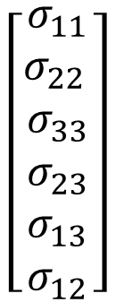
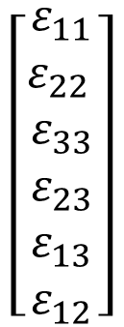
Relationship between Stress/Strain Tensors
Recognizing that stress and strain tensors each have only six unique components, the elasticity tensor, C, must be a 6 x 6 matrix.
$$\left[\begin{aligned}σ_{11} \\ σ_{22 } \\ σ_{33} \\ σ_{23} \\ σ_{13} \\ σ_{12}\end{aligned}\right]$$
$$\left[\begin{aligned}ε_{11} \\ ε_{22 } \\ ε_{33} \\ ε_{23} \\ ε_{13} \\ ε_{12}\end{aligned}\right]$$
=
C_{ijkl}
C has 36 coefficients (21 unique).

Slide 19
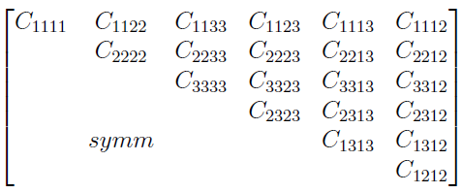
Elasticity Tensor
Extension-Extension Coupling
Extension-Shear Coupling
Extension
C =
Shear
Shear-Shear Coupling

Slide 20


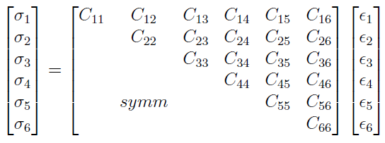
Voigt’s Notation
Replaces double indices with single indices
Need to find all 21 terms of the elasticity tensor OR simplify based on material symmetry

Slide 21
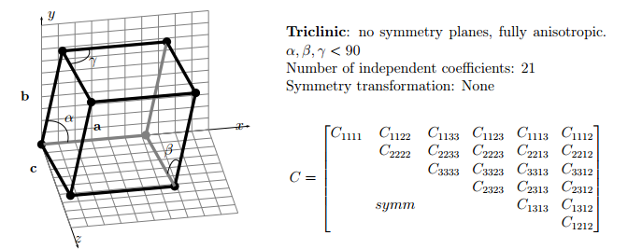
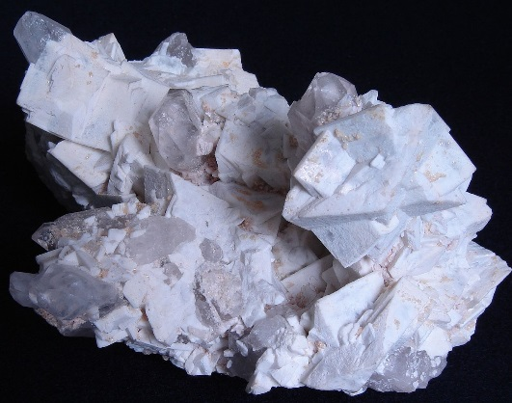
Simplifications of the Elasticity Tensor due to Material Symmetries
Triclinic materials require all elasticity tensor terms because there are NO lines of symmetry
Microcline, example of triclinic crystal
Sides are not perpendicular to one another (no symmetry)
Notes:
Derive coefficient values for orthotropic material in terms of E and “nu”

Slide 22
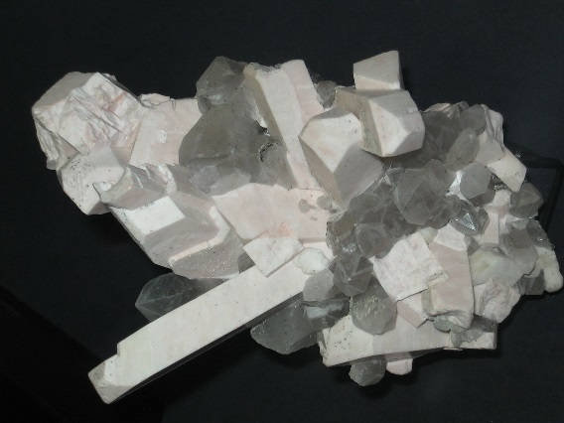
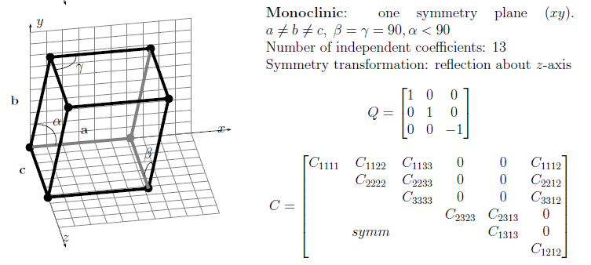
Simplifications of the Elasticity Tensor due to Material Symmetries
Monoclinic materials have one symmetry plane.
Several terms of the elasticity tensor go to zero.
Assumes no interaction between some of the shear-shear and shear-extension terms.
Orthoclase, example of monoclinic crystal
Notes:
Derive coefficient values for orthotropic material in terms of E and “nu”

Slide 23
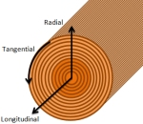
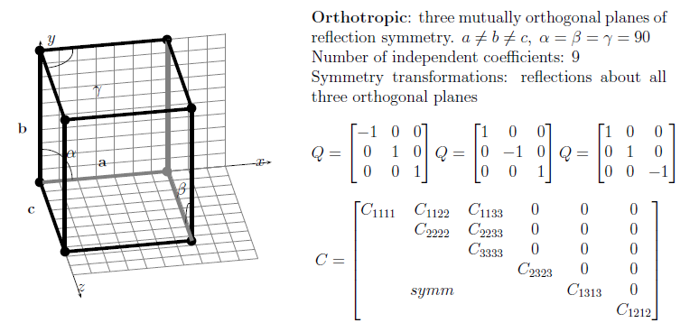
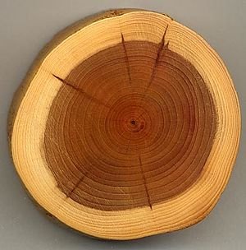
Simplifications of the Elasticity Tensor due to Material Symmetries
Orthotropic materials have 3 orthogonal symmetry planes.
Properties are different in three orthogonal directions
No interaction between normal strains / stresses and shear stresses / strains
No interaction between shear quantities in different planes
Notes:
Derive coefficient values for orthotropic material in terms of E and “nu”

Slide 24

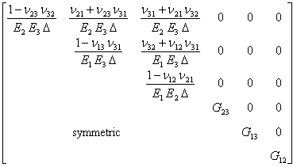
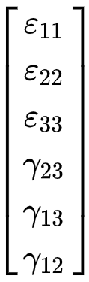

Generalized Hooke’s Law – Orthotropic Materials
The elasticity matrix, C, for an orthotropic material can be written as:
=
Notes:
Note that the strain in one direction is dependent upon stresses in all 3 directions (and vice-versa).
Show derivation of specific matrix components.

Slide 25

Generalized Hooke’s Law – Orthotropic Materials
The inverse of the elasticity matrix for an orthotropic material can be written as:
Note that there are 12 coefficients identified here, but we said that only 9 were unique. The Maxwell-Betti Reciprocity theorem leads to the additional relations between the material coefficients, namely:
$$=\left[\begin{aligned}\begin{matrix}\frac{1}{E_{1}} & \frac{{−ν}_{21}}{E_{2}} & \frac{{−ν}_{31}}{E_{3}} \\ \frac{{−ν}_{12}}{E_{1}} & \frac{1}{E_{2}} & \frac{{−ν}_{32}}{E_{3}} \\ \frac{{−ν}_{13}}{E_{1}} & \frac{{−ν}_{23}}{E_{2}} & \frac{1}{E_{3}}\end{matrix} \begin{matrix}\begin{aligned}0 \\ \\ 0 \\ \end{aligned} & \begin{aligned}0 \\ \\ 0 \\ \end{aligned} & \begin{aligned}0 \\ \\ 0 \\ \end{aligned} \\ 0 & 0 & 0 \\ & & \end{matrix} \\ \begin{matrix}\begin{aligned}0 \\ \\ 0\end{aligned} & \begin{aligned}0 \\ \\ 0\end{aligned} & \begin{aligned}0 \\ \\ 0\end{aligned} \\ & & \\ 0 & 0 & 0\end{matrix} \begin{matrix}\frac{1}{G_{23}} & 0 & 0 \\ 0 & \frac{1}{G_{13}} & 0 \\ 0 & 0 & \frac{1}{G_{12}}\end{matrix}\end{aligned}\right]$$
Compliance matrix, S = C⁻¹
Notes:
Note that the strain in one direction is dependent upon stresses in all 3 directions (and vice-versa).
Show derivation of specific matrix components.

Slide 26






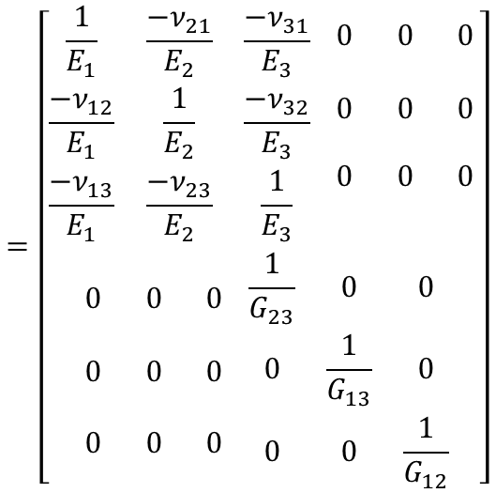
Generalized Hooke’s Law – Orthotropic Materials
$$ε_{11}=\frac{σ_{11}}{E_{1}}−\frac{{ν_{21}σ}_{22}}{E_{2}}−\frac{{ν_{31}σ}_{33}}{E_{3}}$$
$$=\left[\begin{aligned}\begin{matrix}\frac{1}{E_{1}} & \frac{{−ν}_{21}}{E_{2}} & \frac{{−ν}_{31}}{E_{3}} \\ \frac{{−ν}_{12}}{E_{1}} & \frac{1}{E_{2}} & \frac{{−ν}_{32}}{E_{3}} \\ \frac{{−ν}_{13}}{E_{1}} & \frac{{−ν}_{23}}{E_{2}} & \frac{1}{E_{3}}\end{matrix} \begin{matrix}\begin{aligned}0 \\ \\ 0 \\ \end{aligned} & \begin{aligned}0 \\ \\ 0 \\ \end{aligned} & \begin{aligned}0 \\ \\ 0 \\ \end{aligned} \\ 0 & 0 & 0 \\ & & \end{matrix} \\ \begin{matrix}\begin{aligned}0 \\ \\ 0\end{aligned} & \begin{aligned}0 \\ \\ 0\end{aligned} & \begin{aligned}0 \\ \\ 0\end{aligned} \\ & & \\ 0 & 0 & 0\end{matrix} \begin{matrix}\frac{1}{G_{23}} & 0 & 0 \\ 0 & \frac{1}{G_{13}} & 0 \\ 0 & 0 & \frac{1}{G_{12}}\end{matrix}\end{aligned}\right]$$
$$ε_{22}=−\frac{{ν_{12}σ}_{11}}{E_{1}}+\frac{σ_{22}}{E_{2}}−\frac{{ν_{32}σ}_{33}}{E_{3}}$$
$$ε_{33}=−\frac{{ν_{13}σ}_{11}}{E_{1}}−\frac{{ν_{23}σ}_{22}}{E_{2}}+\frac{σ_{33}}{E_{3}}$$
$$γ_{12}=\frac{τ_{12}}{G_{12}}$$
$$γ_{23}=\frac{τ_{23}}{G_{23}}$$
$$γ_{13}=\frac{τ_{13}}{G_{13}}$$

Slide 27
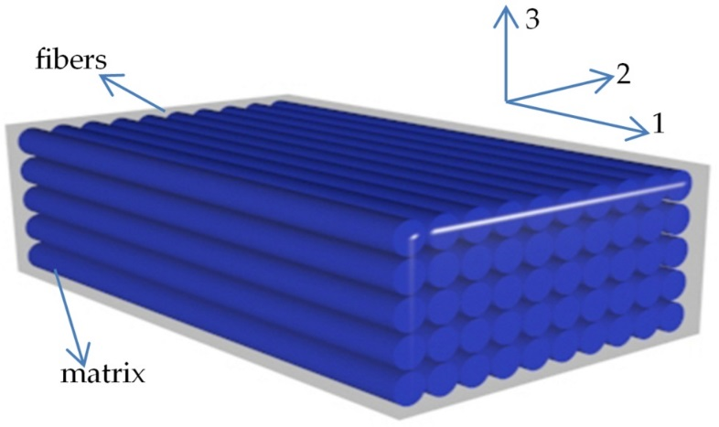
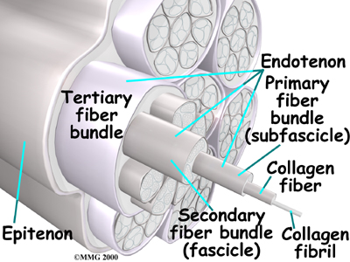
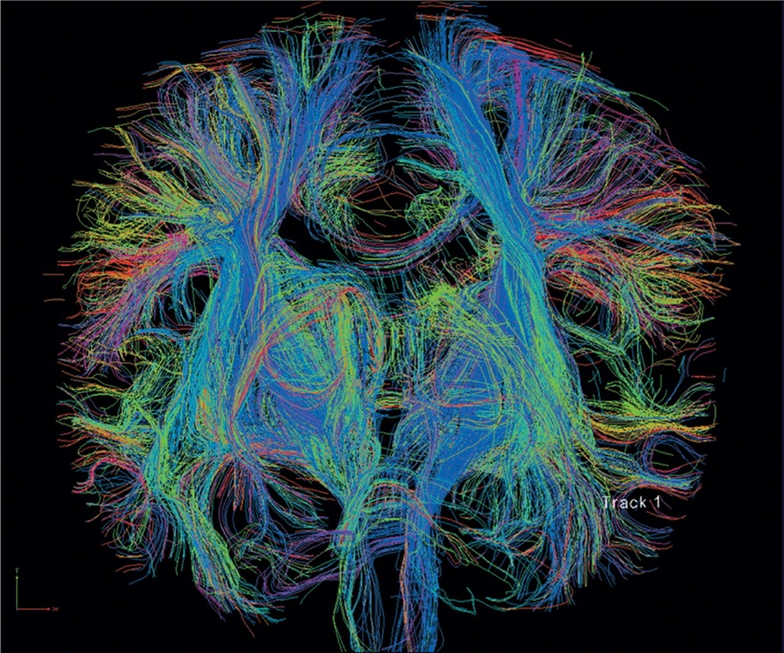
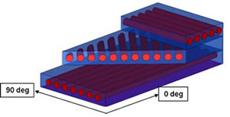
Transverse Isotropic Materials
Transverse isotropy: Material behaviors along 2 axes are identical.
Composites
Tendon
Brain Axonal Tracts

Slide 28
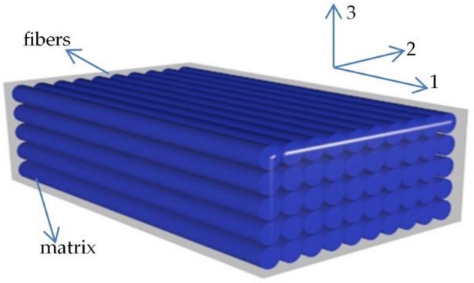

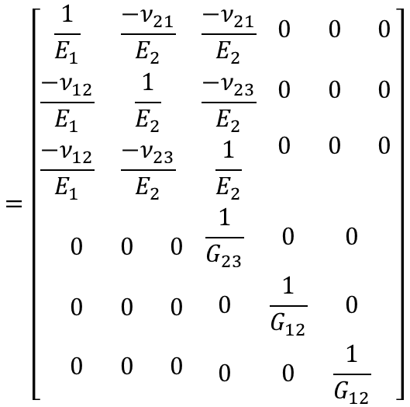
Generalized Hooke’s Law – Transverse Isotropic
Two directions are now similar to each other (assume directions 2 = 3)
$$=\left[\begin{aligned}\begin{matrix}\frac{1}{E_{1}} & \frac{{−ν}_{21}}{E_{2}} & \frac{{−ν}_{21}}{E_{2}} \\ \frac{{−ν}_{12}}{E_{1}} & \frac{1}{E_{2}} & \frac{{−ν}_{23}}{E_{2}} \\ \frac{{−ν}_{12}}{E_{1}} & \frac{{−ν}_{23}}{E_{2}} & \frac{1}{E_{2}}\end{matrix} \begin{matrix}\begin{aligned}0 \\ \\ 0 \\ \end{aligned} & \begin{aligned}0 \\ \\ 0 \\ \end{aligned} & \begin{aligned}0 \\ \\ 0 \\ \end{aligned} \\ 0 & 0 & 0 \\ & & \end{matrix} \\ \begin{matrix}\begin{aligned}0 \\ \\ 0\end{aligned} & \begin{aligned}0 \\ \\ 0\end{aligned} & \begin{aligned}0 \\ \\ 0\end{aligned} \\ & & \\ 0 & 0 & 0\end{matrix} \begin{matrix}\frac{1}{G_{23}} & 0 & 0 \\ 0 & \frac{1}{G_{12}} & 0 \\ 0 & 0 & \frac{1}{G_{12}}\end{matrix}\end{aligned}\right]$$
This applies to the ‘isotropic’ directions (2 and 3 in this case)
There are only 5 unique terms in the above matrix, because
Reciprocity:
For transversely isotropic material:
$$\frac{ν_{12}}{E_{1}}=\frac{ν_{21}}{E_{2}}$$
Notes:
- Discuss tests for material symmetry, e.g. can one test reveal a material’s symmetry characteristics? What about to fully define its mechanical properties?

Slide 29
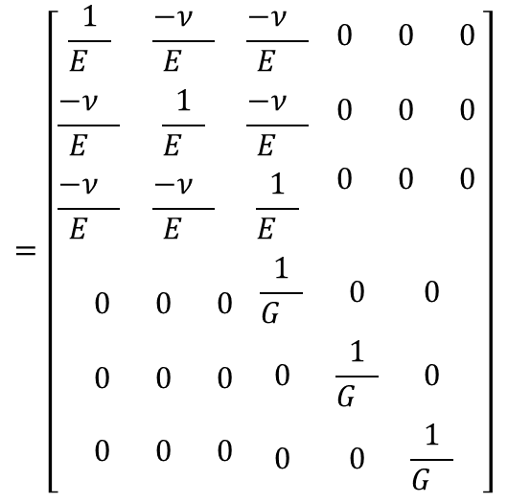



Generalized Hooke’s Law – Isotropic
$E_{1}=E_{2}$= $E_{3}=E$
$G_{12}=G_{23}$= $G_{31}=G$
$v_{12}=v_{23}$= $v_{31}=v$
$$=\left[\begin{aligned}\begin{matrix}\frac{1}{E_{}} & \frac{{−ν}_{}}{E_{}} & \frac{{−ν}_{}}{E_{}} \\ \frac{{−ν}_{}}{E_{}} & \frac{1}{E_{}} & \frac{{−ν}_{}}{E_{}} \\ \frac{{−ν}_{}}{E_{}} & \frac{{−ν}_{}}{E_{}} & \frac{1}{E_{}}\end{matrix} \begin{matrix}\begin{aligned}0 \\ \\ 0 \\ \end{aligned} & \begin{aligned}0 \\ \\ 0 \\ \end{aligned} & \begin{aligned}0 \\ \\ 0 \\ \end{aligned} \\ 0 & 0 & 0 \\ & & \end{matrix} \\ \begin{matrix}\begin{aligned}0 \\ \\ 0\end{aligned} & \begin{aligned}0 \\ \\ 0\end{aligned} & \begin{aligned}0 \\ \\ 0\end{aligned} \\ & & \\ 0 & 0 & 0\end{matrix} \begin{matrix}\frac{1}{G_{}} & 0 & 0 \\ 0 & \frac{1}{G_{}} & 0 \\ 0 & 0 & \frac{1}{G_{}}\end{matrix}\end{aligned}\right]$$
All planes are symmetric (direction of testing or loading doesn’t matter)
There are only 2 unique coefficients required (E, v)
For isotropic materials:
Notes:
- Discuss tests for material symmetry, e.g. can one test reveal a material’s symmetry characteristics? What about to fully define its mechanical properties?

Slide 30
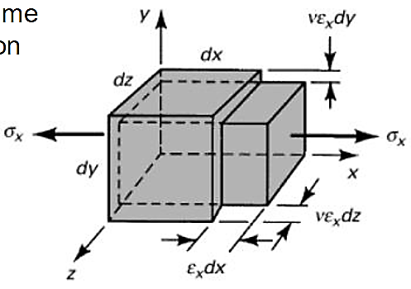



Generalized Hooke’s Law – Example 1
Let’s revisit our example from earlier. Find the strains resulting from uniaxial loading of a linear elastic, isotropic block of material.
$$=\left[\begin{aligned}\begin{matrix}\frac{1}{E_{}} & \frac{{−ν}_{}}{E_{}} & \frac{{−ν}_{}}{E_{}} \\ \frac{{−ν}_{}}{E_{}} & \frac{1}{E_{}} & \frac{{−ν}_{}}{E_{}} \\ \frac{{−ν}_{}}{E_{}} & \frac{{−ν}_{}}{E_{}} & \frac{1}{E_{}}\end{matrix} \begin{matrix}\begin{aligned}0 \\ \\ 0 \\ \end{aligned} & \begin{aligned}0 \\ \\ 0 \\ \end{aligned} & \begin{aligned}0 \\ \\ 0 \\ \end{aligned} \\ 0 & 0 & 0 \\ & & \end{matrix} \\ \begin{matrix}\begin{aligned}0 \\ \\ 0\end{aligned} & \begin{aligned}0 \\ \\ 0\end{aligned} & \begin{aligned}0 \\ \\ 0\end{aligned} \\ & & \\ 0 & 0 & 0\end{matrix} \begin{matrix}\frac{1}{G_{}} & 0 & 0 \\ 0 & \frac{1}{G_{}} & 0 \\ 0 & 0 & \frac{1}{G_{}}\end{matrix}\end{aligned}\right]$$
$$=\left[\begin{aligned}\begin{matrix}\frac{1}{E_{}} & \frac{{−ν}_{}}{E_{}} & \frac{{−ν}_{}}{E_{}} \\ \frac{{−ν}_{}}{E_{}} & \frac{1}{E_{}} & \frac{{−ν}_{}}{E_{}} \\ \frac{{−ν}_{}}{E_{}} & \frac{{−ν}_{}}{E_{}} & \frac{1}{E_{}}\end{matrix} \begin{matrix}\begin{aligned}0 \\ \\ 0 \\ \end{aligned} & \begin{aligned}0 \\ \\ 0 \\ \end{aligned} & \begin{aligned}0 \\ \\ 0 \\ \end{aligned} \\ 0 & 0 & 0 \\ & & \end{matrix} \\ \begin{matrix}\begin{aligned}0 \\ \\ 0\end{aligned} & \begin{aligned}0 \\ \\ 0\end{aligned} & \begin{aligned}0 \\ \\ 0\end{aligned} \\ & & \\ 0 & 0 & 0\end{matrix} \begin{matrix}\frac{1}{G_{}} & 0 & 0 \\ 0 & \frac{1}{G_{}} & 0 \\ 0 & 0 & \frac{1}{G_{}}\end{matrix}\end{aligned}\right]$$
$$\left[\begin{aligned}σ_{11} \\ 0 \\ 0 \\ 0 \\ 0 \\ 0\end{aligned}\right]$$

Slide 31






Generalized Hooke’s Law –Example 2
What if the block is in compression and constrained as shown? How does that change the setup?
$$=\left[\begin{aligned}\begin{matrix}\frac{1}{E_{}} & \frac{{−ν}_{}}{E_{}} & \frac{{−ν}_{}}{E_{}} \\ \frac{{−ν}_{}}{E_{}} & \frac{1}{E_{}} & \frac{{−ν}_{}}{E_{}} \\ \frac{{−ν}_{}}{E_{}} & \frac{{−ν}_{}}{E_{}} & \frac{1}{E_{}}\end{matrix} \begin{matrix}\begin{aligned}0 \\ \\ 0 \\ \end{aligned} & \begin{aligned}0 \\ \\ 0 \\ \end{aligned} & \begin{aligned}0 \\ \\ 0 \\ \end{aligned} \\ 0 & 0 & 0 \\ & & \end{matrix} \\ \begin{matrix}\begin{aligned}0 \\ \\ 0\end{aligned} & \begin{aligned}0 \\ \\ 0\end{aligned} & \begin{aligned}0 \\ \\ 0\end{aligned} \\ & & \\ 0 & 0 & 0\end{matrix} \begin{matrix}\frac{1}{G_{}} & 0 & 0 \\ 0 & \frac{1}{G_{}} & 0 \\ 0 & 0 & \frac{1}{G_{}}\end{matrix}\end{aligned}\right]$$
$$\left[\begin{aligned}ε_{11} \\ ε_{22 } \\ ε_{33} \\ ε_{12} \\ ε_{23} \\ ε_{13}\end{aligned}\right]$$
$$\left[\begin{aligned}{−σ}_{11} \\ ? \\ 0 \\ 0 \\ 0 \\ 0\end{aligned}\right]$$
$$\left[\begin{aligned}ε_{11} \\ 0 \\ 0 \\ ε_{12} \\ ε_{23} \\ ε_{13}\end{aligned}\right]$$
$$=\left[\begin{aligned}\begin{matrix}\frac{1}{E_{}} & \frac{{−ν}_{}}{E_{}} & \frac{{−ν}_{}}{E_{}} \\ \frac{{−ν}_{}}{E_{}} & \frac{1}{E_{}} & \frac{{−ν}_{}}{E_{}} \\ \frac{{−ν}_{}}{E_{}} & \frac{{−ν}_{}}{E_{}} & \frac{1}{E_{}}\end{matrix} \begin{matrix}\begin{aligned}0 \\ \\ 0 \\ \end{aligned} & \begin{aligned}0 \\ \\ 0 \\ \end{aligned} & \begin{aligned}0 \\ \\ 0 \\ \end{aligned} \\ 0 & 0 & 0 \\ & & \end{matrix} \\ \begin{matrix}\begin{aligned}0 \\ \\ 0\end{aligned} & \begin{aligned}0 \\ \\ 0\end{aligned} & \begin{aligned}0 \\ \\ 0\end{aligned} \\ & & \\ 0 & 0 & 0\end{matrix} \begin{matrix}\frac{1}{G_{}} & 0 & 0 \\ 0 & \frac{1}{G_{}} & 0 \\ 0 & 0 & \frac{1}{G_{}}\end{matrix}\end{aligned}\right]$$

Slide 32


Anisotropic Material – Example 3
A unidirectional composite material is used in a design, and is loaded in such a way that the resulting stress state at a critical point is σ₁₁=-3.5MPa, σ₂₂=7.0 MPa, σ₁₂= -1.4 MPa
Determine the resulting engineering strains at this critical point.
$$=\left[\begin{aligned}\begin{matrix}\frac{1}{E_{1}} & \frac{{−ν}_{21}}{E_{2}} & \frac{{−ν}_{31}}{E_{3}} \\ \frac{{−ν}_{12}}{E_{1}} & \frac{1}{E_{2}} & \frac{{−ν}_{32}}{E_{3}} \\ \frac{{−ν}_{13}}{E_{1}} & \frac{{−ν}_{23}}{E_{2}} & \frac{1}{E_{3}}\end{matrix} \begin{matrix}\begin{aligned}0 \\ \\ 0 \\ \end{aligned} & \begin{aligned}0 \\ \\ 0 \\ \end{aligned} & \begin{aligned}0 \\ \\ 0 \\ \end{aligned} \\ 0 & 0 & 0 \\ & & \end{matrix} \\ \begin{matrix}\begin{aligned}0 \\ \\ 0\end{aligned} & \begin{aligned}0 \\ \\ 0\end{aligned} & \begin{aligned}0 \\ \\ 0\end{aligned} \\ & & \\ 0 & 0 & 0\end{matrix} \begin{matrix}\frac{1}{G_{23}} & 0 & 0 \\ 0 & \frac{1}{G_{13}} & 0 \\ 0 & 0 & \frac{1}{G_{12}}\end{matrix}\end{aligned}\right]$$
E_{f}=14 GPa E_{m}=3.5 GPa
G_{fm}=4.2 GPa ν_{fm}=0.4 ν_{mm}=0.1

Slide 33






Anisotropic Material - Example
A unidirectional composite material is used in a design, and is loaded in such a way that the resulting strain state at a critical point is σ₁=-3.5MPa, σ₂=7.0 MPa, τ₁₂= -1.4 MPa
Determine the resulting strains at this critical point.
0
$$ε_{11}=\frac{σ_{11}}{E_{1}}−\frac{{ν_{12}σ}_{22}}{E_{1}}−\frac{{ν_{12}σ}_{33}}{E_{1}}$$
0
E₁=14 GPa E₂=3.5 GPa
G₁₂=4.2 GPa ν₁₂=0.4 ν₂₃=0.1
$$ε_{22}=−\frac{{ν_{12}σ}_{11}}{E_{1}}+\frac{σ_{22}}{E_{2}}−\frac{{ν_{23}σ}_{33}}{E_{2}}$$
0
$$ε_{33}=−\frac{{ν_{12}σ}_{11}}{E_{1}}−\frac{{ν_{23}σ}_{22}}{E_{2}}+\frac{σ_{33}}{E_{2}}$$
0
0
$$γ_{12}=\frac{τ_{12}}{G_{12}}$$
$$γ_{23}=\frac{τ_{23}}{G_{23}}$$
$$γ_{13}=\frac{τ_{13}}{G_{12}}$$

Slide 34





Terms Representing Changes in Volume
In an isotropic material, recall
$$ν=−\frac{lateral strain}{axial strain}$$
$$V_{f}=\left(1+ε_{x}\right)dx\left(1−νε_{x}\right)dy\left(1−νε_{x}\right)dz$$
$$V_{f}={\left[1+\left(ε_{x}−2νε_{x}\right)\right]dxdydz=V}_{0}+ΔV$$
$$e=\frac{ΔV}{V_{0}}=\left(1−2ν\right)ε_{x}=\frac{1−2ν}{E}σ_{x}$$
Dilatational strain,
$$K=V_{0}\frac{−P}{∆V}=\frac{−P}{e}=\frac{E}{3\left(1−2ν\right)}$$
bulk modulus,

Slide 35



3D Strain Energy
Recall: Strain energy density in linear elastic region (i.e., recoverable energy) was:
Note that this equation is for one direction
Stress in one direction produces deformation in other directions, but this doesn’t create work in the other directions
This is because work is the force times the displacement created in the same direction of the force.
In 3D:

Slide 36






Strain Energy in Shear
The definition for strain energy density with shear is analogous
In 1D:
In 3D:
Generalized strain energy density is then equal to:

